Slide 1
Biological degradation with Suma Drain GTS Plus
General description of the principles
Advantages of the new product

Slide 2
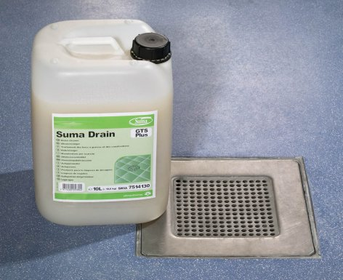
How does Suma Drain work?
Preventative action
Micro-organisms attach to the drain surface coated with organic deposits and build up a biological film
Once attached they digest the organic deposits
Suma Drain GTS plus micro-organisms continue to work until there is food available and/or get flushed through the lines to the grease trap

Slide 3

Drain lines
In spite of chemical and physical treatments, slow-running drains, blockages and malodors are commonly disrupting the collection systems.
Continuous use of chemicals can damage drains causing costly repairs.
Blockages cause additional damage plus inconvenience and embarrassment.

Slide 4
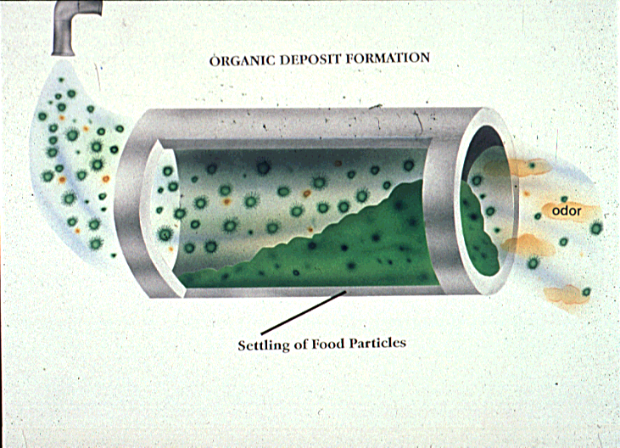
Base film formation
ORGANIC DEPOSIT
+
Food particles accumulate
Odors develop

Slide 5
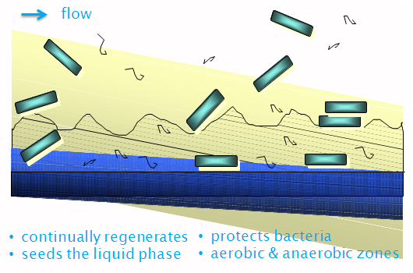
Drain line and grease trap treatment
Based on biofilm formation
Micro-organisms form a thinner, more active biofilm that out-competes other micro-organisms and degrades grease and other organics

Slide 6
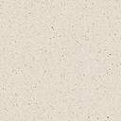


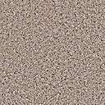
Grease Trap System Function
Restaurants are required to have
grease traps to keep excessive
grease from collecting downstream
in the collection system.
Problems:
Expensive to pump
Back-ups cause damage, sanitation problems, and expensive repairs
Failure to contain grease leading to sewer overload
Odors

Slide 7
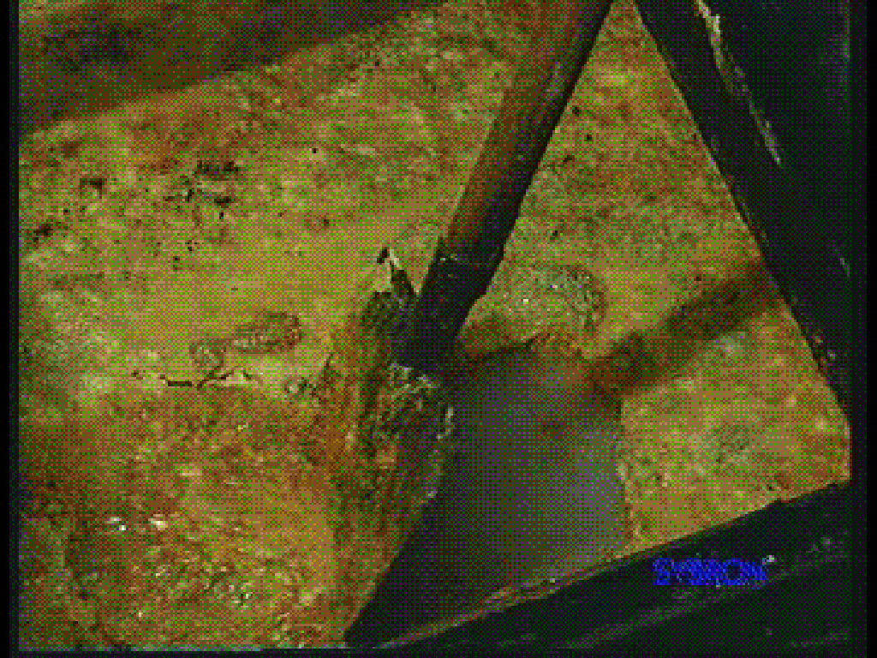
Grease Traps Collect
Grease
Meat scraps, milk
Potatoes, potato peels
Plate scrapings
Enzymes produced by bacteria can initiate breakdown and degrade specific foods (see next slide):
Lipase breaks down fat
Protease breaks down proteins such as meat & cheese
Amylase degrades starches such as potatoes & bread
Cellulase breaks down plant fiber from vegetables

Slide 8
Bacterial Cell - enzyme function
Small, soluble compounds
Extracellular polysaccharide
intracellular enzymes
CO₂ & H₂O
Membrane bound enzymes
Large molecules
Extracellular enzymes
Bacteria will digest the organic soils like grease, proteins, starch and fats. In this the enzymatic processes within the bacteria play a very important role.
Notes:
Once produced enzymes may perform one of three ways:
1) simply diffuse into the cytoplasm where it can act on small molecular weight material transported into the cell.
intracellular enzymes
2) be held within the cell wall where it may act on larger compounds which become bound to the cell wall.
membrane bound enzymes
3) be extruded from the cell to attack larger molecules to be broken down to a size whereby they can be adsorbed or even brought into the cell.
extracellular enzymes
The cell can bring only extremely small molecules into the cell for food. Larger particles are adsorbed to the cell by the polysaccharide in the cell’s capsule. Here it remains in place to be acted on by cell bound and extracellular enzymes until it is small enough to be brought into the cell. Very large particles are broken down by extracellular enzymes.
Grease chunks or globules are extremely large relative to the cell. The most successful organisms in an environment where grease is the major food source, can produce biosurfactants to emulsify the oil into smaller particles to expedite the process. We sometimes assist the process by adding surfactants.

Slide 9
Suma Drain GTS PLUS
Introduction of new blend of spores
including a new patented strain

Slide 10
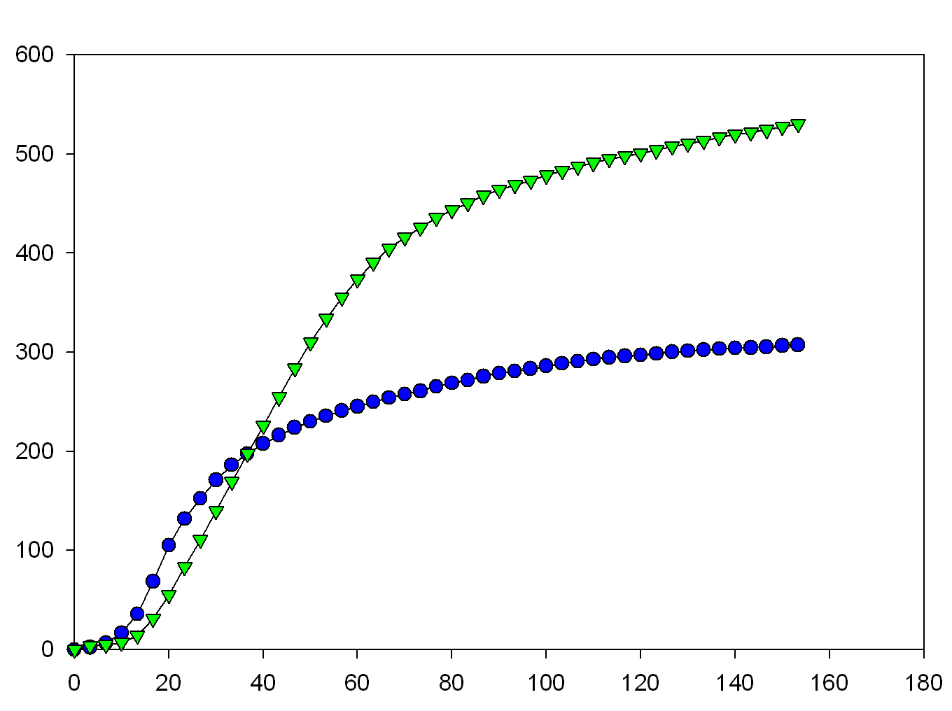
The best technology on the market just got better
Micro-organisms in GTS Plus breakdown organics faster than the market standard.
Respirometry was used to monitor the effectiveness of synthetic sludge degradation by comparing GTS Plus blend and the standard microbial blend as measured by oxygen consumption.
The cumulative uptake is 74% higher for the GTS Plus microbial blend, indicating far better degradation activity.
GTS Plus
Cumulative Oxygen Uptake, mg/L
Ref.
Time, hours

Slide 11
Enzyme profiles of GTS Plus
The GTS Plus blend demonstrates superior cellulase, lipase and protease enzyme production when compared to the market leading blend. Both blends produce high levels of amylase.
Differentiated media on Petri plates visibly demonstrate breakdown of organic compounds by producing a “zone of clearing” (hydrolysis) around each colony. A given quantity of microbial culture is spotted onto a disk that is placed on a Petri plate containing a solid media (substrate) that allows visualization of an enzyme reaction.
As the targeted enzyme is produced and diffuses throughout the media, a “zone of clearing” is created where the substrate is broken down by the enzyme. The zones of clearing are measured from the edge of a microbial colony outwards to the edge of the zone of clearing.

Slide 12
Lipase
  Fats, oils and grease are major portions of soils and organic deposits.
  The GTS Plus blend produces a lipase enzyme that breaks down the fats, oils and grease into its more basic biodegradable components.
The GTS Plus shows a deeper green
color revealing that more triglycerides were broken down, i.e. GTS Plus
produced more lipase enzyme, when compared to the reference.
Lipase plate
Zones of clearing
Ref.
Zones of clearing
GTS Plus
MSB
Zones of clearing
MSB
BioS™
BioS™
Enzyme profiles of GTS Plus, cont’d
GTS Plus and reference are each spotted onto separate disks placed on a Petri plate containing a lipase medium. As lipase is excreted, the triglycerides are hydrolyzed and the pH drops in the area where the break down has occurred.

Slide 13
Protease
Casein plate
Proteases are enzymes that hydrolyze peptide bonds in proteins to break down the large structure into smaller groups of amino acids.
Due to the high degree of charged amino acids in proteins they are usually very sticky, and the proteases produced by the microbial blend help to reduce this stickiness by breaking down the protein into more readily biodegradable parts.
Zones of clearing
Ref.
GTS Plus
GTS Plus produces a significantly higher level of protease when compared to the market standard.
GTS Plus and reference are each spotted onto separate disks placed on a Petri plate containing a casein skim milk medium. As protease is produced and excreted, a zone of clearing becomes visible where the skim milk has been broken down.

Slide 14
Amylase
Is present in most food substances.
Contributes to soiling by causing particles to stick more readily to surfaces.
The amylase produced by the GTS Plus blend breaks down the starch into a more biodegradable form, reducing the stickiness of particles and making them easier to remove.
Both GTS Plus and reference blend produce considerable levels of amylase.
Zones of clearing
GTS Plus and Ref. blend are each spotted onto
separate disks placed on a Petri plate containing
a starch medium. As amylase is produced and
excreted, the starch is broken down.
After the Petri plate is stained with a iodine solution,
the zone of clearing becomes visible where the starch
has been broken down.
Ref
GTS Plus
Starch plate stained with an iodine solution

Slide 15
Cellulase
Is the most abundant biological compound on earth.
Is present in stains, grime and organic deposits.
The GTS Plus blend produces cellulase enzymes that break down this large chain insoluble molecule into much smaller water soluble, more easily biodegradable fragments.
CMC plate stained with Congo red solution
The GTS Plus blend produces significantly more cellulase when compared to the reference blend
Zones of clearing
Both blend are spotted onto separate disks placed on a Petri plate containing a carboxymethylcellulose (CMC) medium. As cellulase is produced and excreted, the CMC is broken down.
After the plate is stained with a congo red solution, the zone of clearing becomes visible around the colony where the CMC has been broken down.
MSB
BioS™

Slide 16
Suma Drain GTS PLUS
Additional benefits:
New patented strain for effective degradation of Long Chain Fatty Acids

Slide 17
Long Chain Fatty Acids
  Short chain fatty acids generally degradable
  Long chain fatty acids are much more difficult to degrade
  80-90% of the residual grease that causes maintenance problems is the bound or unbound long chain fatty acids.
  Specifically palmitic, stearic, and oleic acids

Slide 18
Grease Trap Material from Florida restaurant fatty acid profile
Field samples verify residual LCFA’s
Oleic
Palmitic
Stearic

Slide 19
Field samples verify residual LCFA’s
Grease Trap Material
From Fast Food Restaurant
fatty acid profile
Oleic
Palmitic
Stearic

Slide 20
Degradation of long chain fatty acids:
Experience indicates that Gram negative strains most effectively degrade long chain fatty acids.
Literature confirms that Gram negative strains are most effective at degrading long chain fatty acids.
Problem: Gram negative strains do not produce spores and therefore are not as stable in liquid formulations.

Slide 21
(1) Waste kitchen grease degradation by new strain
Degradation rate exceeds Gram negative strains
140
120
100
GTS Plus
80
Cumulative Oxygen Uptake (mg)
Standard spore
base
60
40
Effective Gram
Negative degraders
20
0
0
Time (hours)

Slide 22
(2) Waste kitchen grease degradation by new strain
.
Again GTS Plus degrades at higher rate than Gram negatives, but slower to initiate.
400
350
GTS Plus
300
250
Cumulative Oxygen Uptake,(mg)
200
150
Gram negative
Fatty acid
degraders
100
50
0
0
Time (hours)

Slide 23
pH functionality:
In many grease traps the build-up of fatty acids lowers pH to levels toxic to bacterial action.
    This is often a problem in fast food restaurants that do not use dishwashers. Flows are lower and the percentage of grease in the effluent is very high.
Patented strain was specifically selected to have the ability to function in low pH conditions.

Slide 24
GTS Plus growth rate as a function of pH
0.5
0.45
50% of growth retained
at pH 4.5
0.4
0.35
0.3
0.25
Growth Rate
0.2
0.15
0.1
0.05
0
3
3.5
4
4.5
5
5.5
6
6.5
7
7.5
8
8.5
Final pH
Notes:
Demonstration protocol…
Test tubes, orbital shaker
Soluble substrate (1000 ppm)
Long chain fatty acid, pure broth culture
Optical density measurements, 580_{nm}
Buffers: MES, MOPS, EPPS, KH₂PO₄, Tartaric Acid

Slide 25
Odor Control:
GTS Plus controls odors by degrading the short chain fatty acids that cause odors.
Palmitic
Valeric
Butyric
Acetic
Stearic

Slide 26
Benefits of Suma Drain GTS Plus with new blend of spores and patented strain
Faster degradation to eliminate build-ups of proteins, fats, oils, grease, starches and toilet tissue.
  Degrades long chain fatty acids for improved grease removal
  Improved enzyme production means improved degradation and removal of proteins, fats, oils, grease, starches and toilet tissue for better cleaning, eliminating build-ups in drains and grease traps.
  Activity 74% higher than the current product on simulated drain sludge.
  Eliminates odors of short chain fatty acids.
  Reduce mechanical cleaning
  Grows at low pH
  Contains stable spore-forming Bacillus sp.
  Non toxic, safe to use
  Lipophilic nature of microbe improves contact leading to faster activity.

Slide 27
Directions for use – Suma Drain GTS Plus
  Pump the grease trap out.
  Initial seeding: directly dose into the trap.
  Maintenance dosage: daily from the upstream drain lines.
  Set the timer on so as to inject Suma Drain GTS Plus 1-2 hours after the end of the working hours.

Slide 28
Suma Drain GTS Plus dosage guideline
  Commercial kitchens:
    Seeding: 1,2 liter per m³ of trap (directly into the trap)
    Maintenance: with a dosing pump including timer
Number of meals | Dosage/day
400 – 500 | 350 ml (minimum dosage rate)
500 - 800 | 350 – 500 ml
800 - 1000 | 500 – 600 ml
1000 - 1500 | 600 – 1000 ml
>1500 | 1200 ml

Slide 29
Conclusion
Improved performance in applications
Drain lines and grease traps
Faster degradation to eliminate build-ups of proteins, fats, oils, grease, starches and toilet tissue

