Slide 1

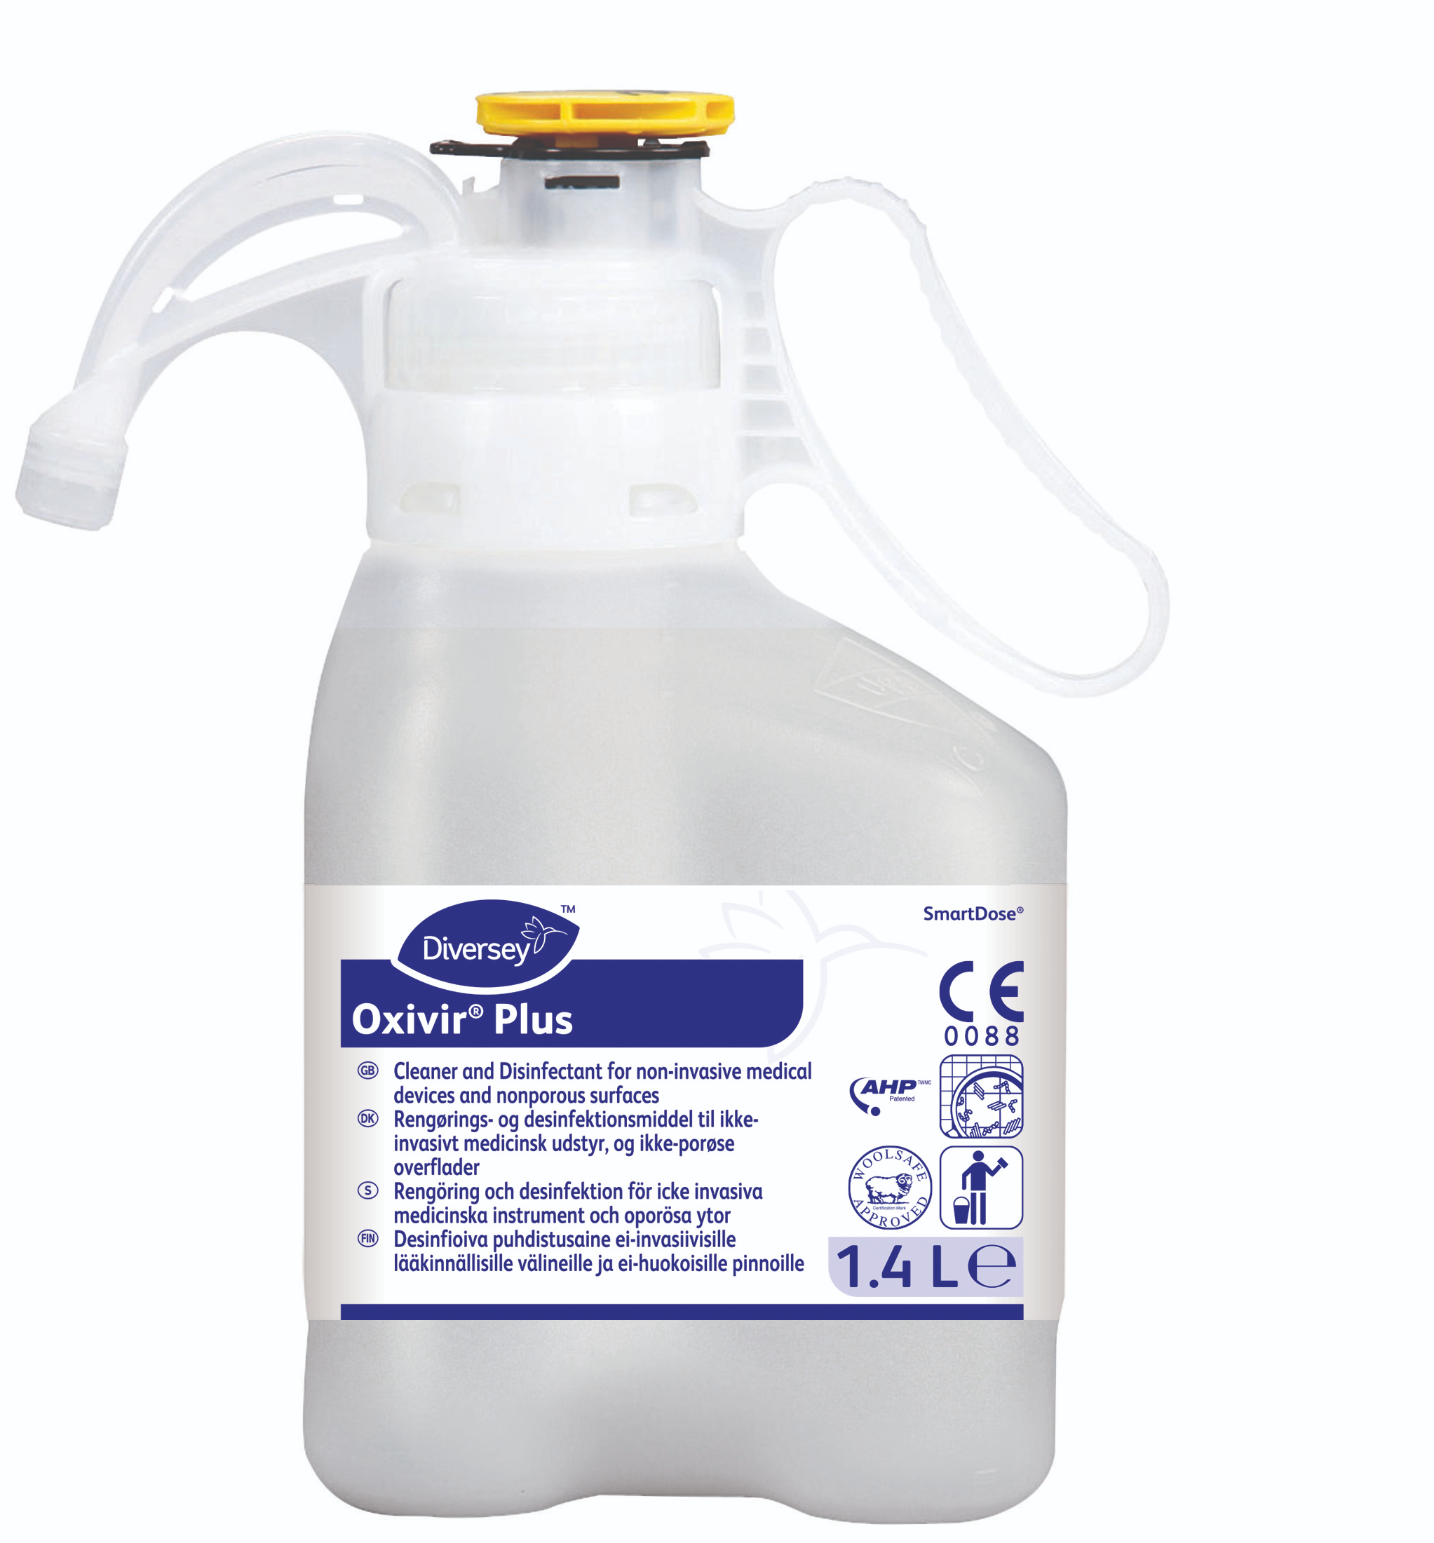
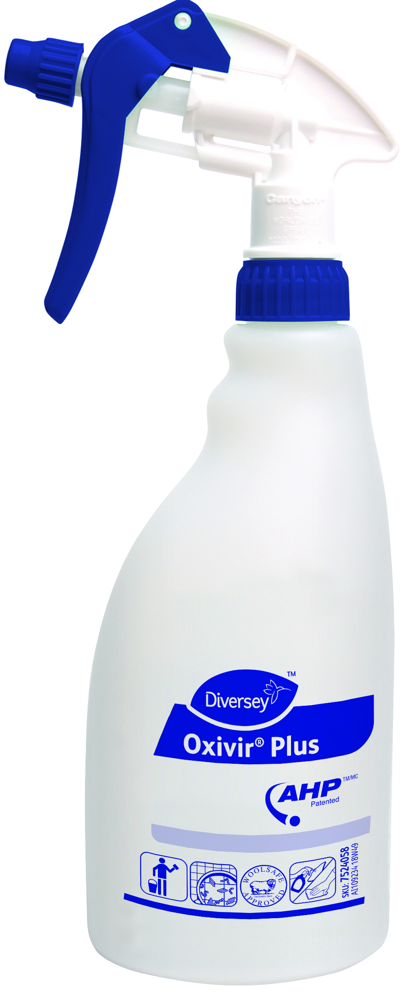
Oxivir Plus SmartDose
1 Simple cleaner disinfectant solution
Perfect solution for keeping surfaces clean & disinfected
Reduce cleaning time.
Reduce training.
Reduce chemical cost.
Available in dosing systems
Oxivir Plus is the ideal cleaner disinfectant to keep surfaces looking clean with strong surfactants and at the same time keeping infections at bay with its excellent disinfectant properties to tackle bacteria & viruses- especially critical for the flu season which will be upon us soon
Keep surfaces clean & safe
Reduce training
Reduce chemical cost
Safe to use (active evaporates into oxygen & water)
SmartDose dosing platform

