Slide 1
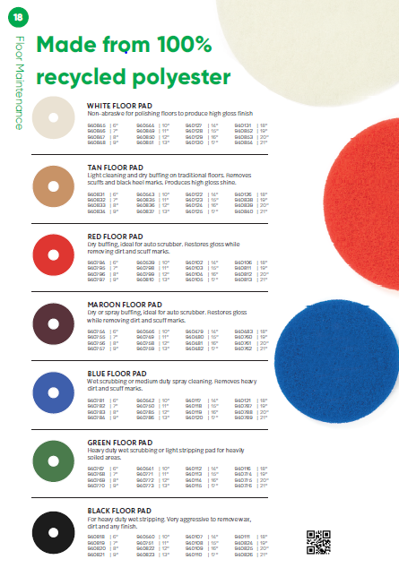
Select the right pad for the job.

